Slide 1
Classification Technical Report
BY
Ahmed Abdelatty
Ahmed.Abdelatty@utdallas.edu

Slide 2
Outline
Background:
Over Sampling.
Task 1:
Data description.
Data preprocessing.
Experiments and Results.
Data Splitting.
Task 2:
Data description.
Data preprocessing.
Experiments and Results.
Conclusion.
References.

Slide 3
Outline
Background:
Over Sampling.
Task 1:
Data description.
Data preprocessing.
Experiments and Results.
Data Splitting.
Task 2:
Data description.
Data preprocessing.
Experiments and Results.
Conclusion.
References.

Slide 4
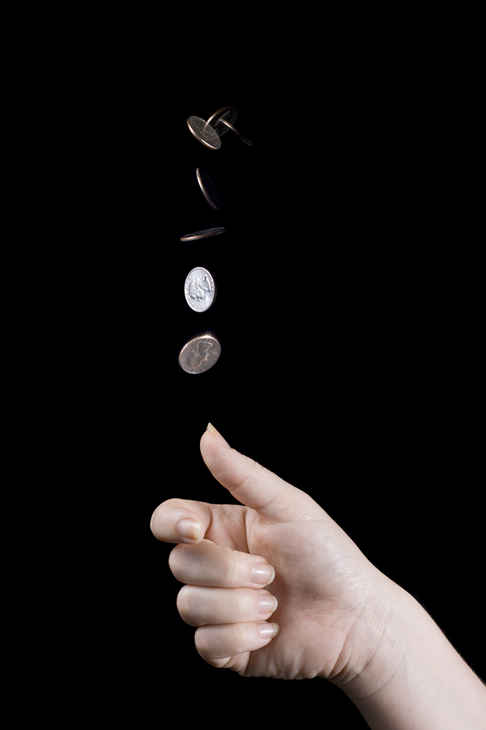
Over Sampling
Oversampling [1] is a bias correction technique that is used to adjust the class distribution of a given classification dataset.
For example, assume that we toss a fair coin for 100 times out of which we got 70 heads. To adjust our dataset to represent the fact that tails must come up to 50% of the times we use over sampling.

Slide 5
Over Sampling Algorithms
Simple or Random oversampling: sample with replacement from the misrepresented class until we have a balanced dataset.
Synthetic Minority Oversampling Technique (SMOTE) [2]: instead of repeating already exiting data points, SMOTE generate new samples by sampling a datapoint from the misrepresented class then find it’s k nearest neighbor from the same class and generate their weighted average as the new datapoint.
The adaptive synthetic sampling approach (ADASYN) [3]: same as SMOTE, however, they are different on how they select the weights when finding the average.

Slide 6
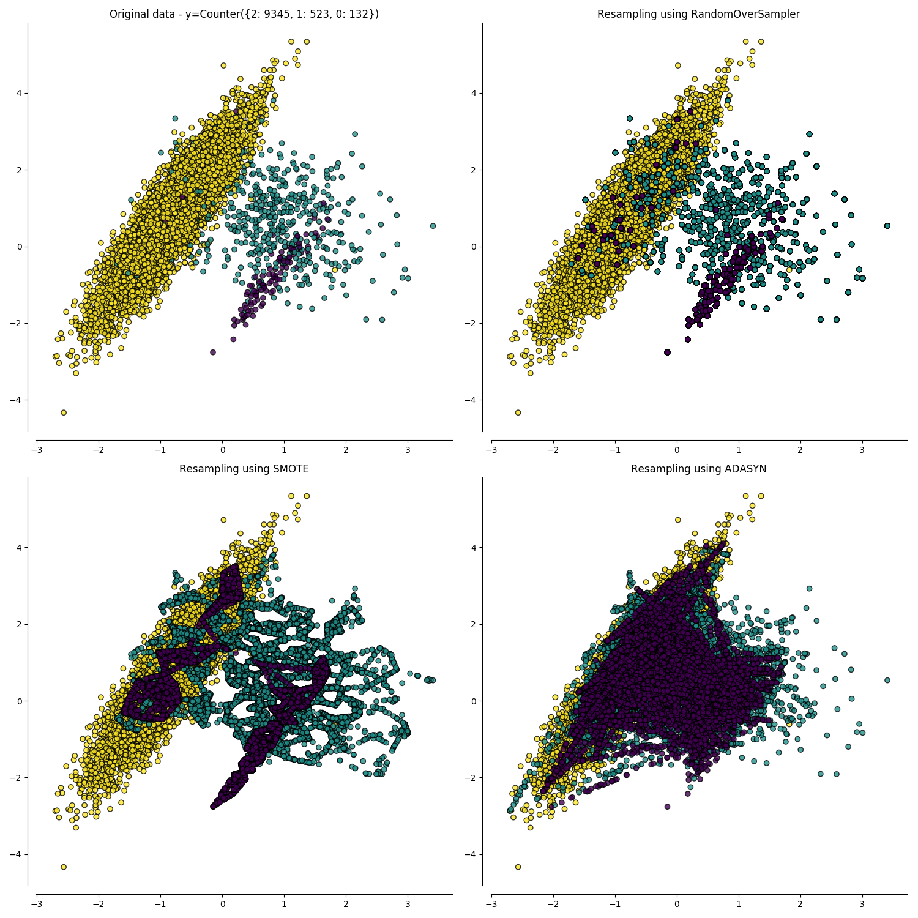
Over Sampling Algorithms (Cont.)
Source.

Slide 7
Outline
Background:
Over Sampling.
Task 1:
Data description.
Data preprocessing.
Experiments and Results.
Data Splitting.
Task 2:
Data description.
Data preprocessing.
Experiments and Results.
Conclusion.
References.

Slide 8
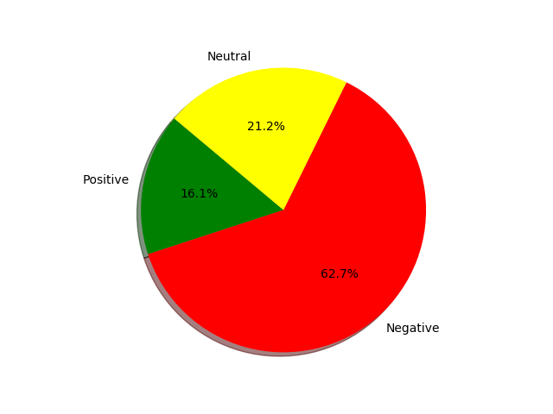
Task 1 (Data description)
The dataset contains tweets about six US airline companies, each of which is labelled as: positive, negative, and neutral. The total number of tweets is 14,640 and label distribution is given as follows:

Slide 9
Task 1 (Data preprocessing)
Data preprocessing was splitted into 4 levels:
Level 1: cleaning tweets by removing stop words, converting all words into lower case, stemming all words, and optionally removing (special characters, mentions, hashtags, and links).
Level 2: extract features either using term frequency (tf), tf-idf or word2vec.
Level 3: use Principal component analysis for dimensionality reduction.
Level 4: use over sampling to adjust the class distribution, because of the imbalanced nature of the dataset.

Slide 10
Task 1 (Experiments and Results)
The dataset was splitted into 80% training and 20% testing.
Multiple classification techniques was used (Linear SVM, Naïve Bayes (NB), KNN, AdaBoost (AB), and GradientBoosting (GB))
The pretrained TextBlob sentiment classifier have been used also, but got 54% accuracy.

Slide 11
Task 1 - Experiments (parameter tuning )
To obtain the highest possible accuracy I did a lot of parameter tuning including:
Selecting which levels of preprocessing to apply.
Tuning the parameters of each classifier: for KNN K is selected between {1,3,5,7,10,15}, for NB Laplace smoothing is selected between {.5,1,1.5,2,2.5,3,5,7}, for Linear SVM the slack constant C is selected between {1,.1,.2,2,5,10,20}, for both GradientBoosting and AdaBoost number of estimators is selected between {50,100,200}.

Slide 12
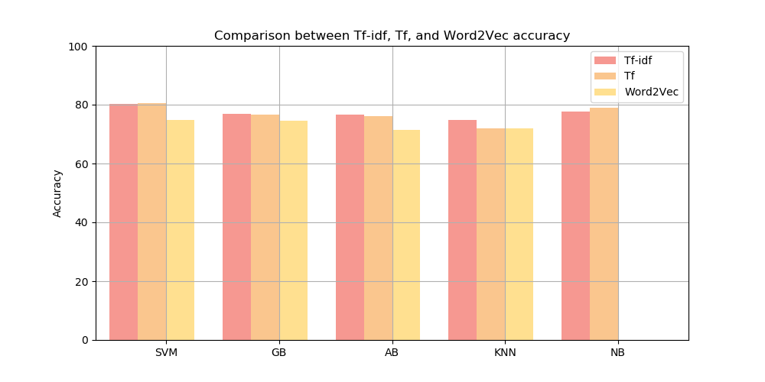
Task 1 - Results
Best performance for SVM and Naïve Bayes was obtained by applying tf only (Level 1,2 preprocessing) on the entire dataset. On the other hand, the best performance for GradientBoosting, KNN, and AdaBoost was obtained by applying tf-idf only (Level 1,2 preprocessing) on the entire dataset.

Slide 13
Task 1 – Results (Cont.)
Accuracy of different classification techniques without using PCA
 | RandomOverSampler |  |  | SMOTE |  |  | ADASYN |  |  | None
 | Tf | Tf-idf | W2V | Tf | Tf-idf | W2V | Tf | Tf-idf | W2V | Tf | Tf-idf | W2V
SVM | 78.14 | 77.16 | 69.96 | 78.79 | 79.2 | 70.35 | 78.04 | 77.97 | 69.02 | 80.6 | 80.26 | 74.72
GB | 73.43 | 72.82 | 69.65 | 73.5 | 75.58 | 67.79 | 75.44 | 75.00 | 70.63 | 76.74 | 76.81 | 74.52
AB | 71.35 | 68.66 | 56.33 | 75.34 | 71.82 | 63.49 | 72.33 | 73.33 | 65.78 | 76.16 | 76.63 | 71.45
KNN | 63.8 | 62.68 | 6466 | 41.97 | 38.18 | 48.80 | 39.03 | 37.23 | 66.19 | 72.06 | 74.76 | 71.99
NB | 78.42 | 77.23 | ––––– | 79.51 | 78.72 | ––––– | 78.03 | 78.24 | ––––– | 79.06 | 77.56 | –––––

Slide 14
Task 1 – Results (Cont.)
Classification Report for the best classifier
 | precision | recall | f1-score | support
negative | .85 | .91 | .88 | 1889
neutral | .66 | .53 | .59 | 580
positive | .77 | .70 | .73 | 459
avg / total | .80 | .81 | .80 | 2928

Slide 15
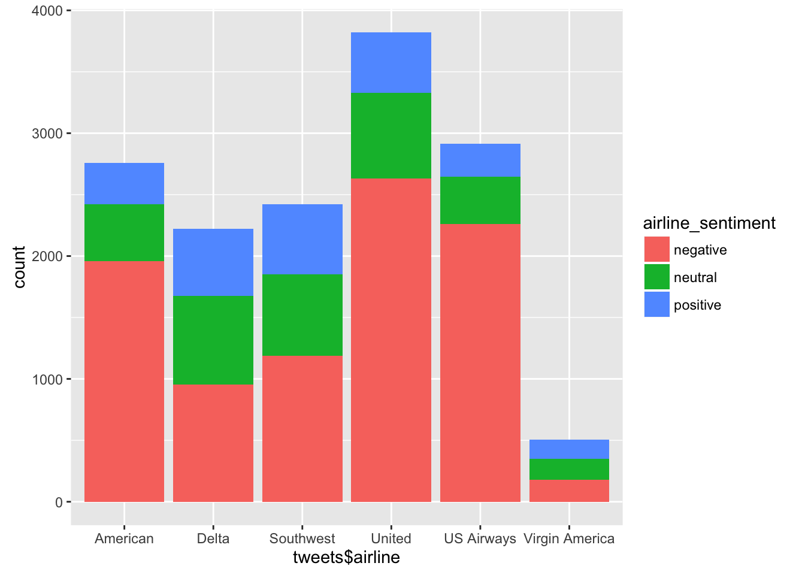
Task 1 - Data Splitting (different approach)
Recall: the dataset contains tweets about six US airline companies. In this approach, I divided the data set into 6 small datasets, every one of which contains tweets about one of the airlines.
6 different models was trained: one for each dataset. This approach was proposed in [4].
Source.

Slide 16
Outline
Background:
Over Sampling.
Task 1:
Data description.
Data preprocessing.
Experiments and Results.
Data Splitting.
Task 2:
Data description.
Data preprocessing.
Experiments and Results.
Conclusion.
References.

Slide 17
Task 2 - Data description
The dataset contains images of the Turkish sign language digits. The dataset has 10 class for digits from 0 to 9. The total number of images is 2,062 and labels are almost evenly distributed.

Slide 18
Task 2 - Data preprocessing
Level 1 :All images have been converted into gray scale, then resized to 64X64 instead of 100X100. For the training of the Convolution Neural Network (CNN) purpose labels have been converted to one hot encoding. For the purpose of training other classifiers (SVM, etc) every image has been flattened into 4,096 feature vector.
Level 2: Due to the high dimensionality of the data, I applied PCA for all classifiers except the CNN.

Slide 19
Task 2 - Experiments and Results
The dataset was splitted into 20% testing and the remaining 80% was splitted into 80% training and 20% validation.
Multiple classification techniques (Linear SVM, CNN, KNN, AB, and GB).

Slide 20
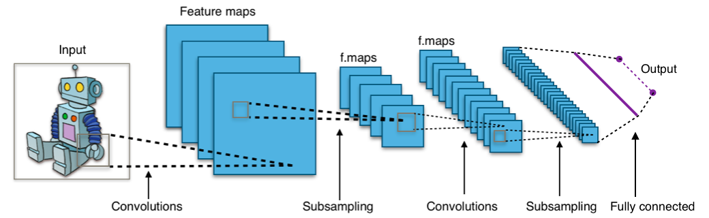
Task 2 – Experiments (CNN design)
Where
Convolution layers contain 3X3 kernels.
Subsampling is done by 2X2 max pooling layers.
The fully connected layer is to flatten the all the learned features and combine them.
Then, flattened features are passed to a softmax to predict the label of the input data.
Source

Slide 21
Task 2 – Experiments (CNN structure)
Input layer 64X64X1.
Convolution layer 32- 3X3 kernel.
2X2 max pooling.
Convolution layer 64- 3X3 kernel.
2X2 max pooling.
Convolution layer 128- 3X3 kernel.
2X2 max pooling.
Convolution layer 256- 3X3 kernel.
2X2 max pooling.
Flatten layer.
Dense layer 256 units.
Softmax 10 units.

Slide 22
Task 2 – Experiments (CNN training)
The network is trained using the Adam optimizer (A Method for Stochastic Optimization) [5] with categorical cross entropy as the loss function. Training was early stopped after a specific number of iterations to prevent overfitting.

Slide 23
Task 2 - Experiments (parameter tuning )
To obtain the highest possible accuracy I did a lot of parameter tuning including:
Selecting which levels of preprocessing to apply.
Tuning the parameters of each classifier: for KNN K is selected between {1,3,5,7,10,15}, for Linear SVM the slack constant C is selected between {1,.1,.2,2,5,10,20}, for both GradientBoosting and AdaBoost number of estimators is selected between {50,100,200}.
To prevent CNN overfitting, I used random Dropout with a varying percentage between layers also used early stopping by tuning the number of epochs.

Slide 24
Task 2 - Results
CNN accuracy on train, validation, and test data after 65 epochs for 8 runs
Train Accuracy % | Validation Accuracy % | Test Accuracy %
99.32 | 97.58 | 96.80
99.24 | 94.85 | 95.15
99.24 | 96.76 | 97.09
99.47 | 97.58 | 97.85
99.24 | 98.18 | 98.06
99.85 | 98.48 | 97.04
99.92 | 98.48 | 98.06
99.70 | 97.27 | 97.82

Slide 25
Conclusion
Classification techniques used: Linear SVM, CNN, KNN, NB, AB, and GB.
Text feature extractors used: tf, tf-idf, and word2vec.
Principal Component Analysis (PCA) have been used for dimensionality reduction.
Three Over Sampling techniques have been used: Random oversampling, Synthetic Minority Oversampling Technique (SMOTE), and The adaptive synthetic sampling approach (ADASYN).
For the sentiment analysis task, the best test accuracy obtained was 80.6% and was obtained by SVM. On the other hand, the best classification test accuracy I got for the Turkish sign language dataset was 98.06% and was obtained by Convolution Neural Networks.

Slide 26
Refrences:
[1] https://en.wikipedia.org/wiki/Oversampling_and_undersampling_in_data_analysis
[2] https://www.cs.cmu.edu/afs/cs/project/jair/pub/volume16/chawla02a-html/chawla2002.html
[3] http://sci2s.ugr.es/keel/pdf/algorithm/congreso/2008-He-ieee.pdf
[4]https://www.researchgate.net/publication/315643035_Online_Social_Media-based_Sentiment_Analysis_for_US_Airline_companies
[5] https://arxiv.org/abs/1412.6980

